Slide 1
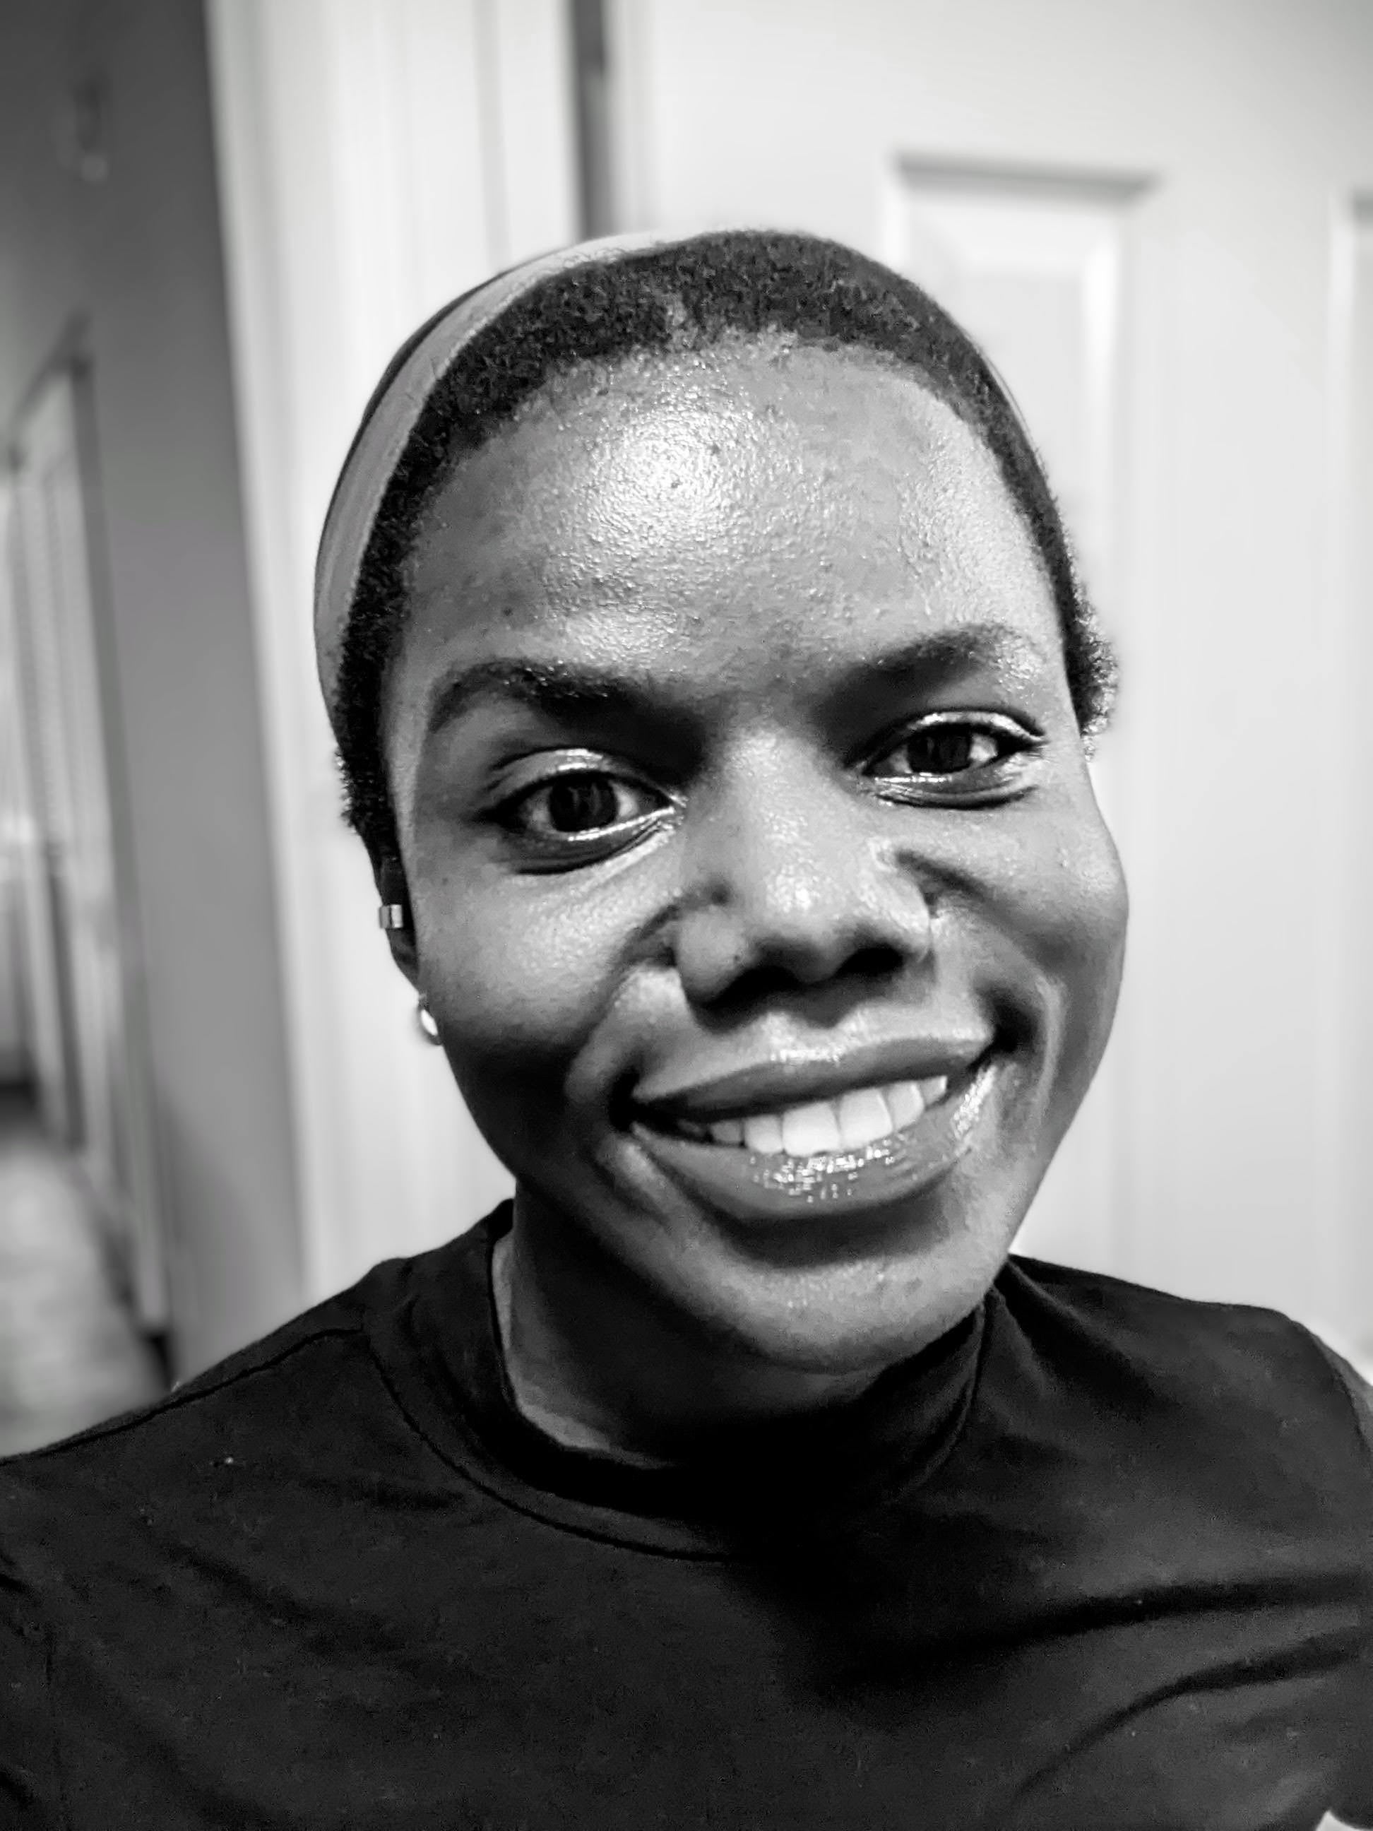
MACHINE-LEARNING SYSTEMS
Hi, I'm Stellamaris.
A research scientist who loves systems.
I’m glad to share my record; built, trained and optimized end-to-end, and ascertained through my work ethic.
Stellamaris Na
Representation Learning
Document Intelligence
Earth / Geo Systems
Research Scientist
8+ years · 9 publications
Notes:
Warm hello. I'm a research scientist who loves systems — 8+ years across national labs and academia. This deck is my record, earned through work ethic.

Slide 2
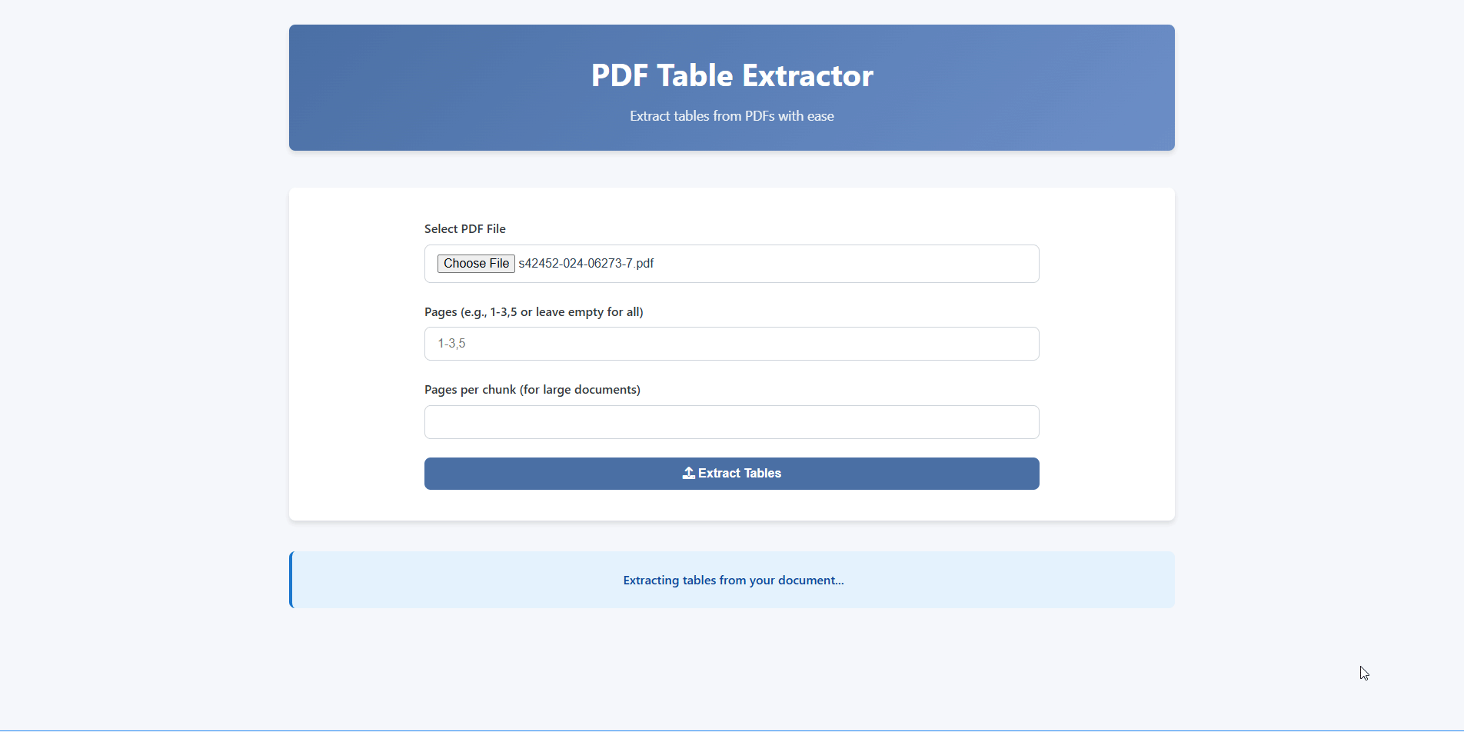
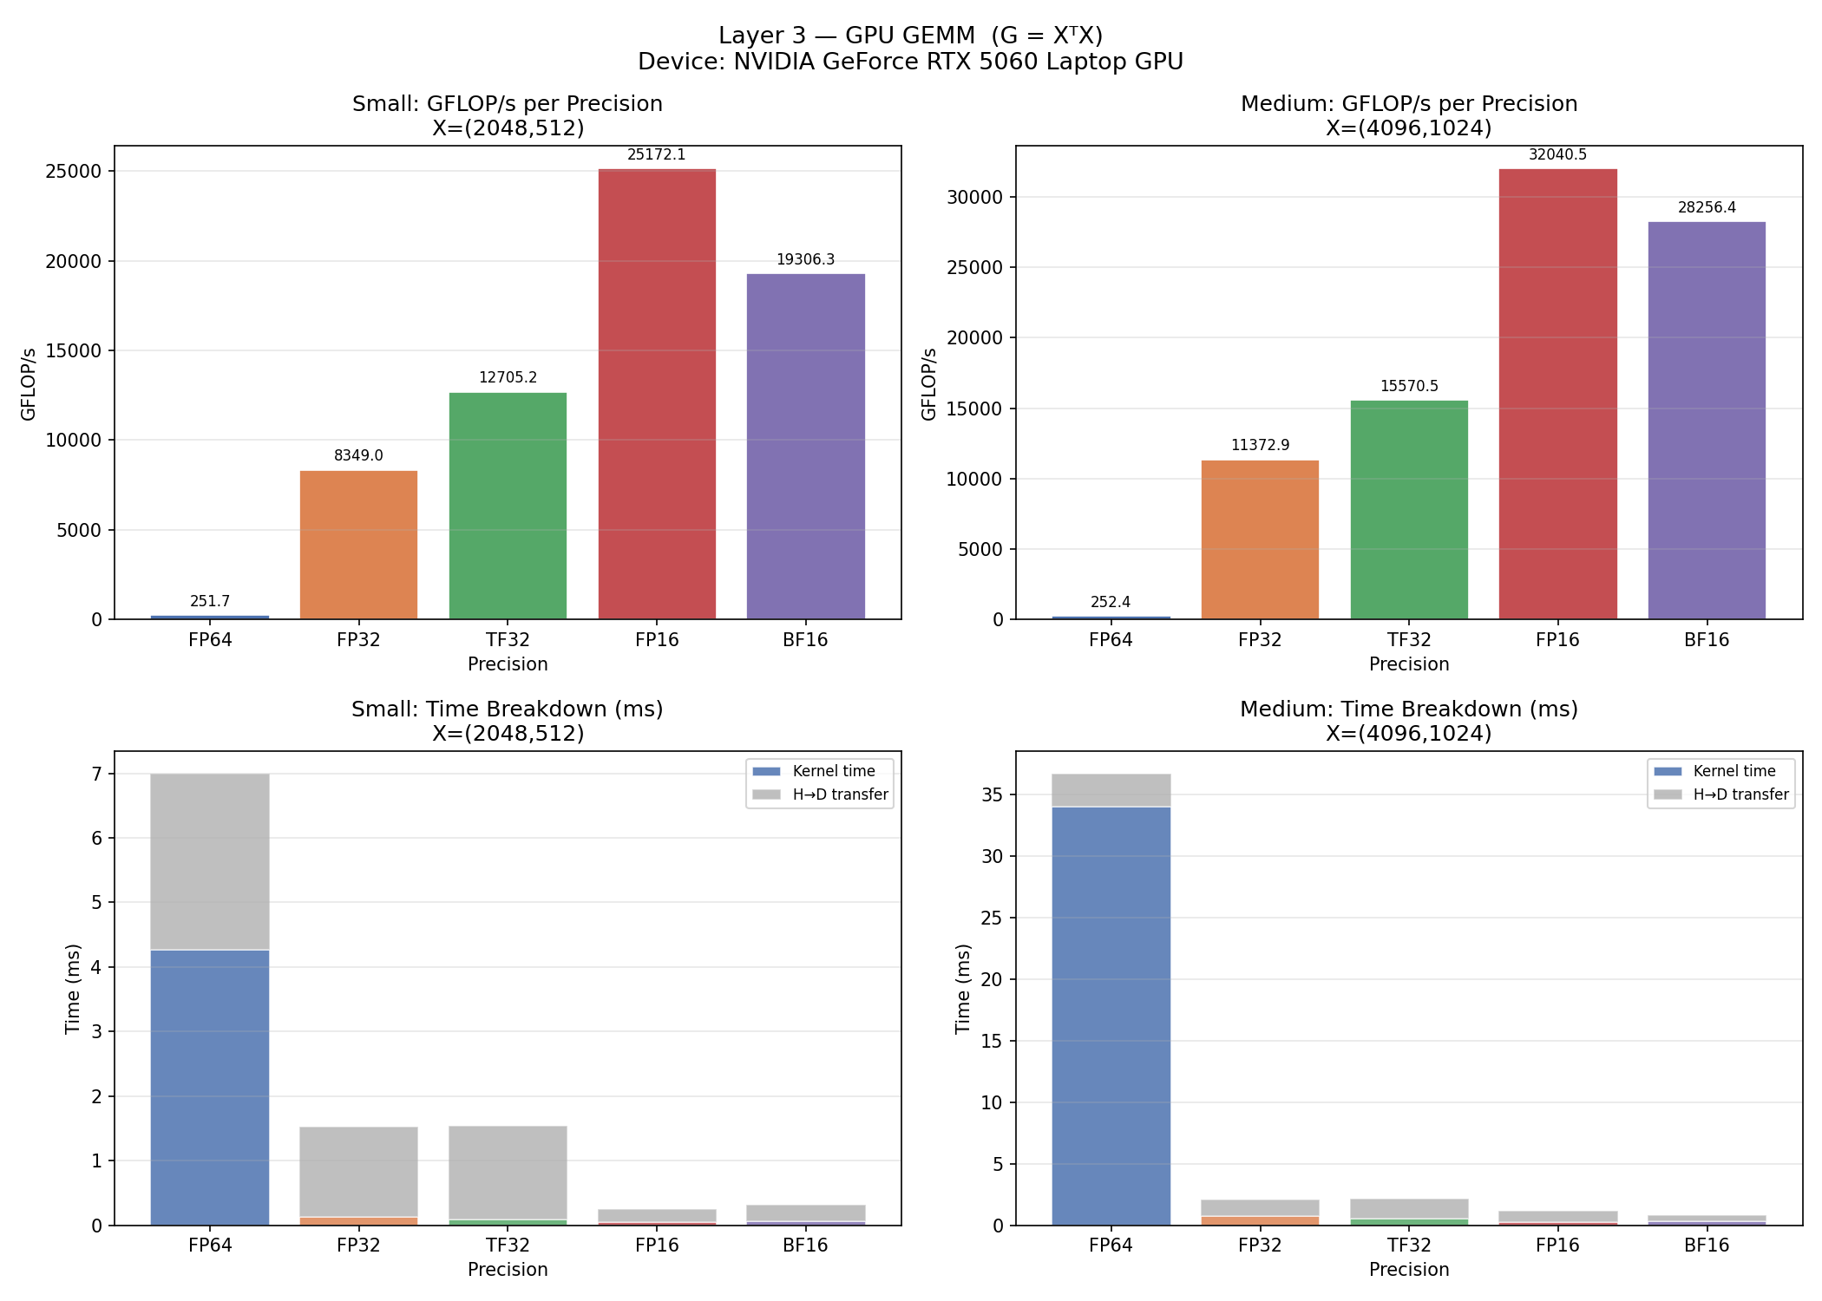
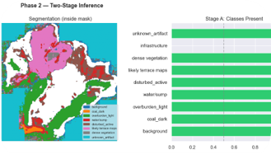
PROTOTYPE · TRAIN · OPTIMIZE · SHIP
Science & Engineering
Questions turned products
G = X⊤X
FP64→BF16
REPRESENTATION LEARNING
ENGINEERING · SHIPPED
RESEARCH DISTILLATION
AI Production – Case: Document
Intelligence
For advance computing & system optimization
Pre-trained modelling & testing
Notes:
What I build: self-supervised representation learning, shipped engineering tools, and the systems work underneath — profiling the kernels that train models, mixed precision from FP64 to BF16.

Slide 3
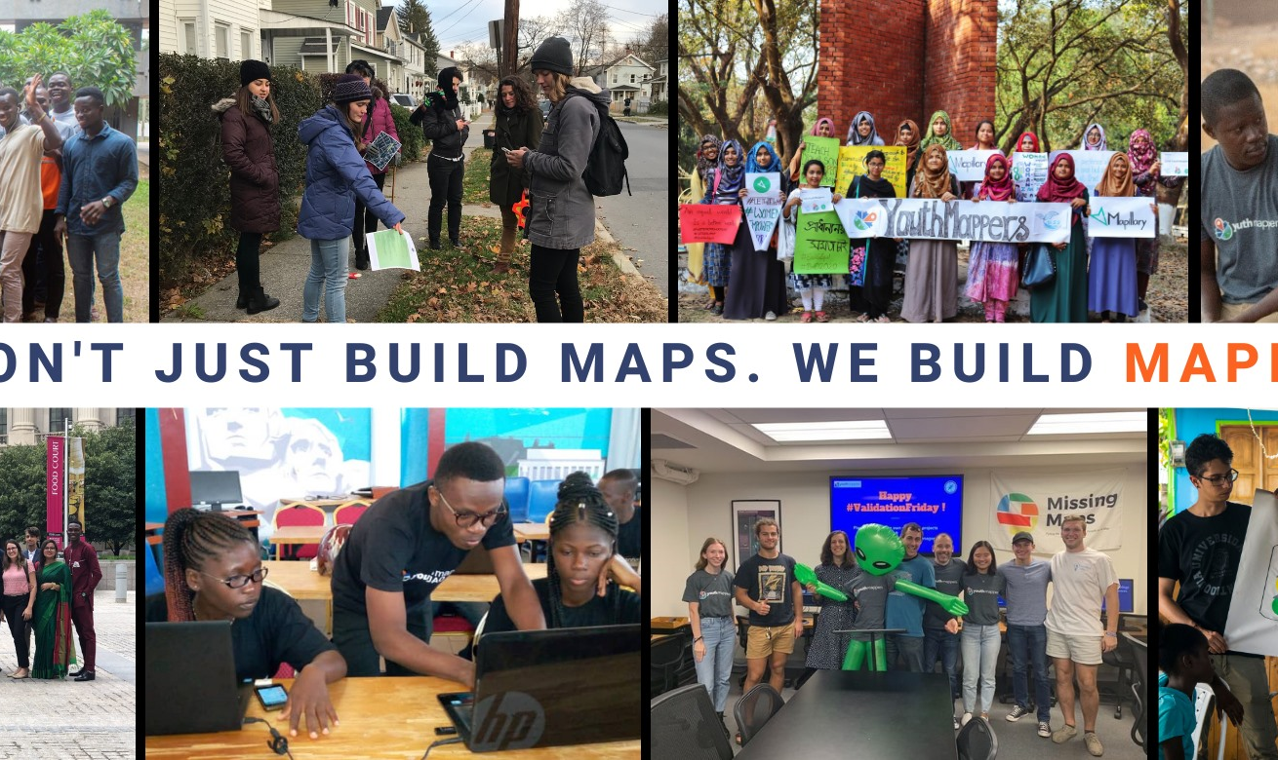

PUBLISH · MENTOR · SCALE
Leadership
Yes, I can, with work that gets cited — a community that keeps growing.
Publication progress
Cited by
Citations
All
Since 2021
h-index
61
60
i10-index
2
2
CITED BY
YEAR
Building & scaling a geo-learning community
Publications
2
2
Digital humanitarians for the sustainable development goals: YouthMappers as a hybrid movement
34
2022
P Solís, S Rajagopalan, L Villa, MB Mohiuddin, E Boateng…
Journal of Geography in Higher Education 46 (1)
2023
Open mapping towards sustainable development goals: voices of youthmappers on community engaged scholarship
24
P Solís, M Zeballos
Springer Nature
Cities of the Future Need to Be Both Smart and Just: How We Think Open Mapping Can Help
2
2022
S Nakacwa, B Manieson
Open Mapping towards Sustainable Development Goals
Combining Volunteered Geographic Information and WPdx standards to improve mapping of rural water infrastructure in Uganda
1
2022
S Nakacwa, B McCusker, K Sill, C Clark, R Nealon…
Proceedings of the Academic Track at State of the Map
YOUTHMAPPERS NETWORK
A National Critical Minerals and Materials Prospectus and Resource Assessment Methodology
–
2025
We build mappers, not just maps
A Wendt, C Creason, D Justman, N Maymi, R Yesenchak, S Nakacwa…
National Energy Technology Laboratory (NETL)
40 → 400+ chapters
80+ countries
26M+ OpenStreetMap edits
Notes:
Leadership: 9 peer-reviewed publications and 61 citations on Google Scholar, and building & scaling a geo-learning community from 40 to 400+ university chapters across 80+ countries — 26M+ OpenStreetMap edits.

Slide 4
LET'S CONNECT
Like what you see?
Open to Research Science & AI Engineering roles.
stellamarisus16@gmail.com
linkedin.com/in/stellawava
stelladataarc.com
Google Scholar
Notes:
Like what you see? Let's connect — I'm open to research science and AI engineering roles.

